Slide 1
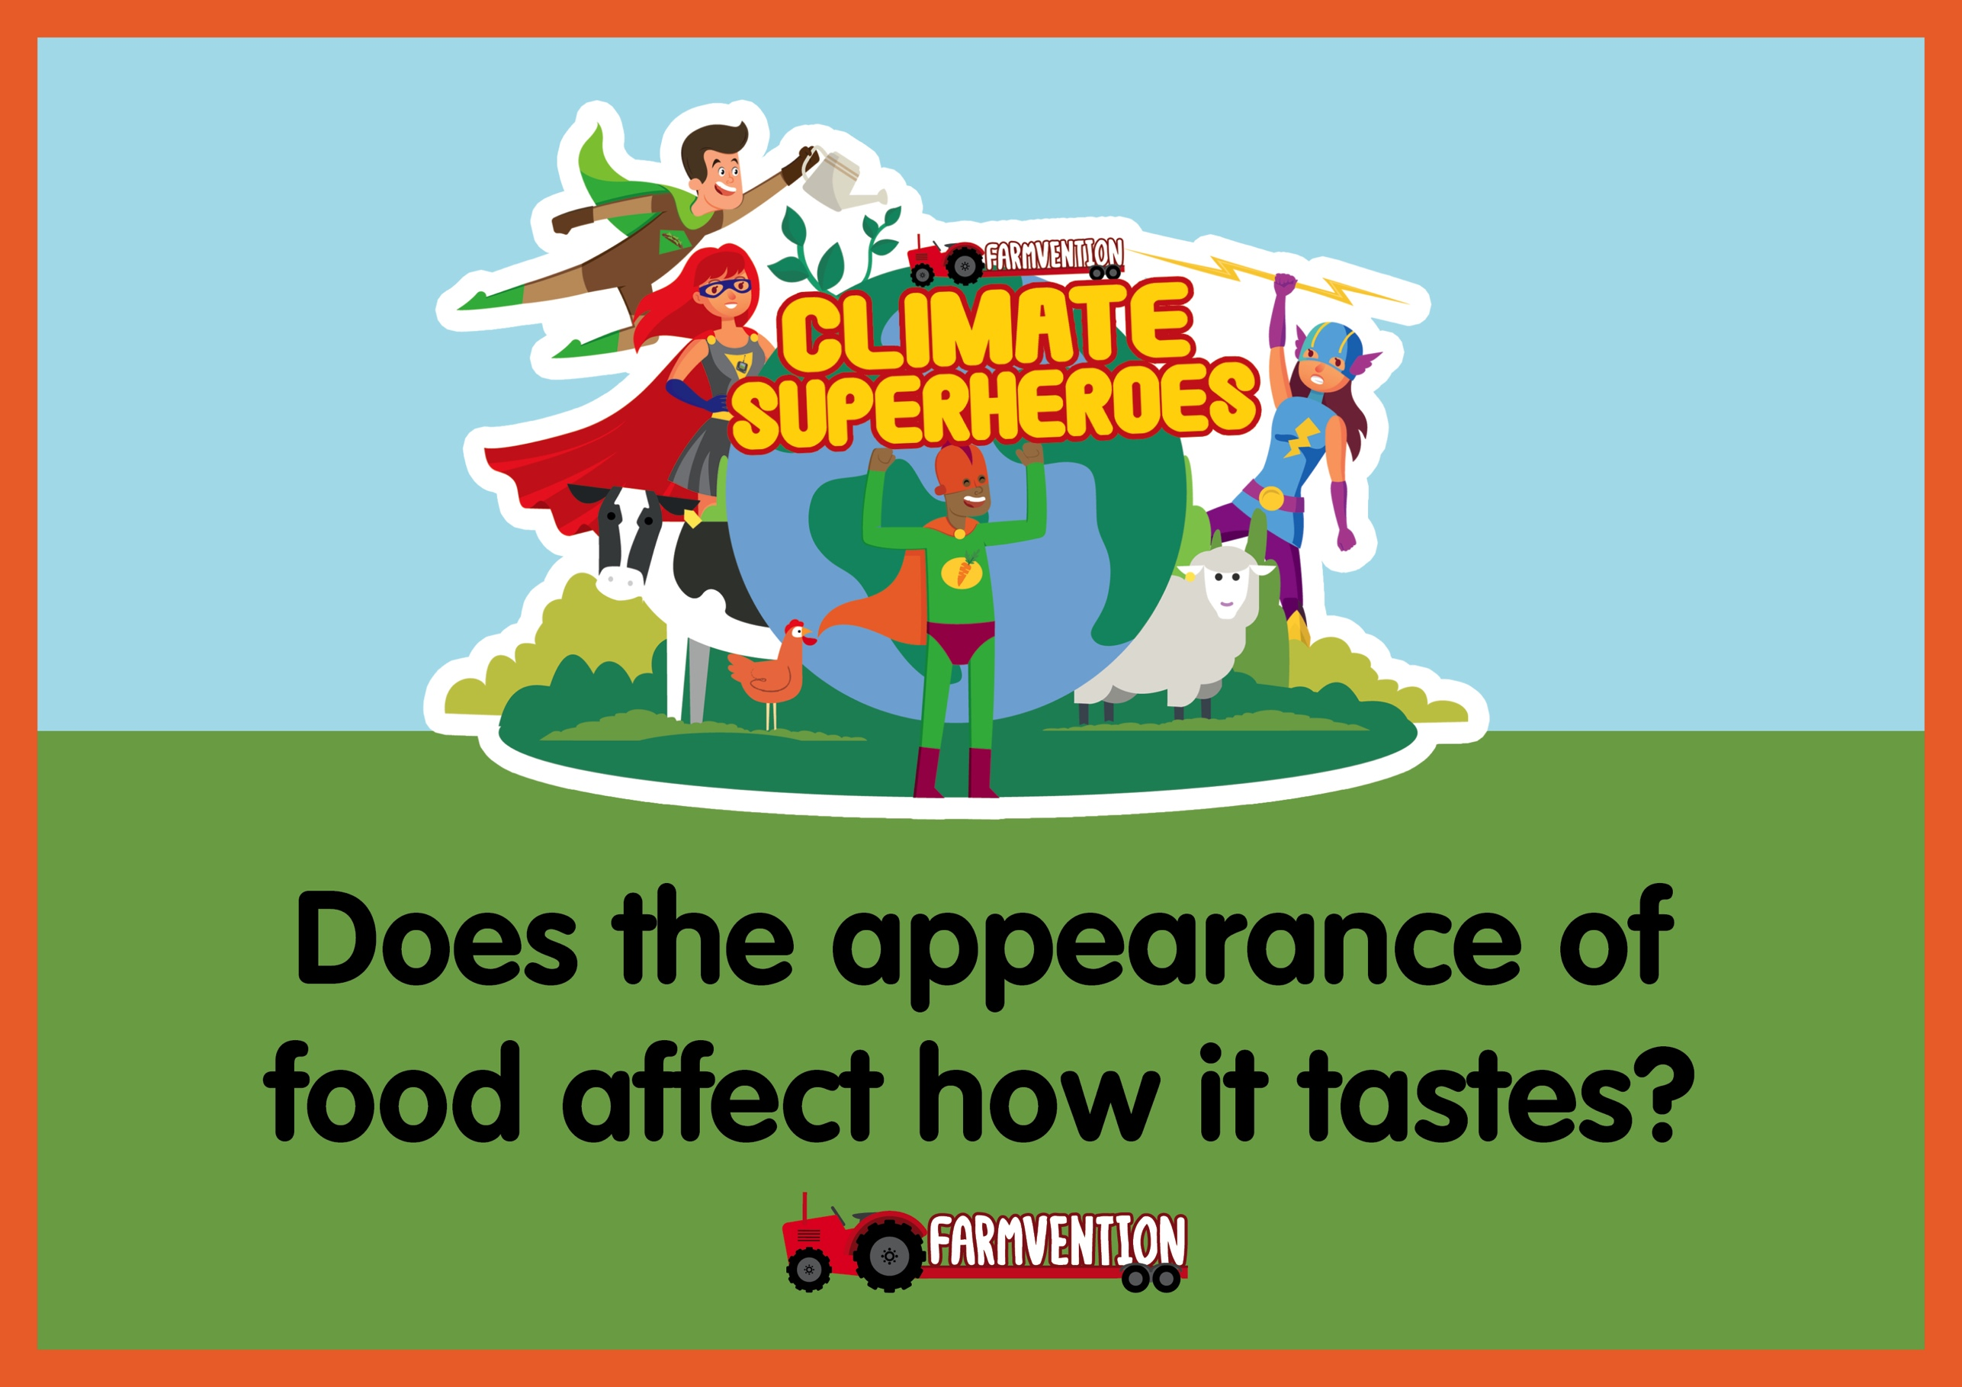
Notes:
Slide 1:
Landing slide
Slide 2:
Discussion about foods commonly grown on UK farms.
Slide 3:
Introduction to the concept of ‘wonky’ vegetables.
Slide 4:
Our question for the project: Does the shape of food affect the way it tastes?

Slide 2
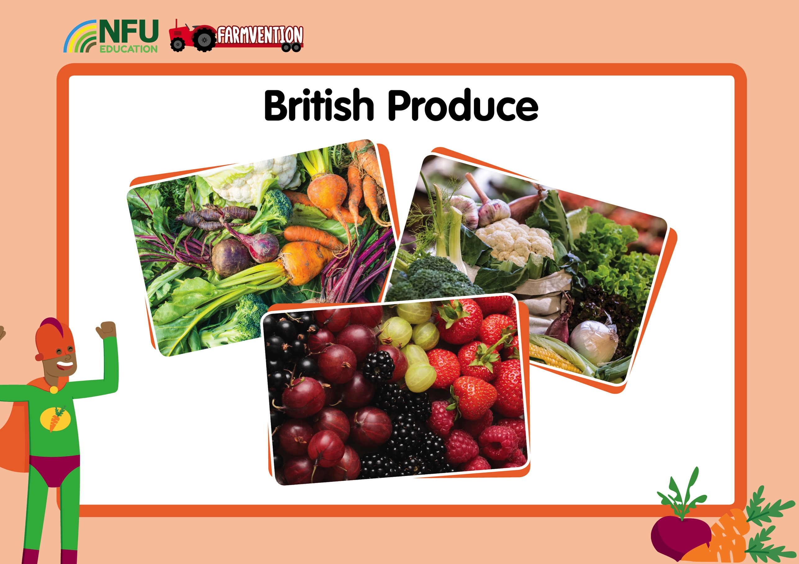
Notes:
Discuss with children which foods we get from UK farms. You could ask:
Where do we get fruit and vegetables from?
Have you ever been to a farm? What food sources did you see?
What did you have for dinner last night? Which parts of your meal came from farms?
What are your favourite fruits and vegetables? Do you think we can grow these in the UK?
Produce commonly grown on UK farms includes carrots, potatoes, onions, parsnips, broccoli, cabbage, celery, courgettes, tomatoes and apples. Discuss which of these children like to eat and the fact that all of these foods are healthy.
If you are carrying out this activity at home, you could explore your cupboards to see what you have that has been grown in the UK. If you are carrying it out at school, you could try and find out where your snack time fruit has been grown.
This video looks at some of the produce that is harvested in UK farms and could be used to familiarise children with farming processes: https://www.youtube.com/watch?v=L1PdwQOurgU
These videos show different vegetables growing and show the whole journey from planting to arriving in supermarkets:
Carrots – https://www.youtube.com/watch?v=Pf74rrn1uLk
Peppers – https://www.youtube.com/watch?v=wpYWSdH9rPE
Potatoes – https://www.youtube.com/watch?v=lYBuY-DnCJc
Tomatoes – https://www.youtube.com/watch?v=PGoPGAR5OMw
If you want to contact a farmer to discuss this actually on the farm you could look for a farm using this link https://www.countrysideclassroom.org.uk/places or even Facetime (or Skype) a farmer which you can arrange via this link https://www.facetimeafarmer.com Always remember if you are visiting a farm check the safety code of practice https://bit.ly/2Mu9xRp

Slide 3
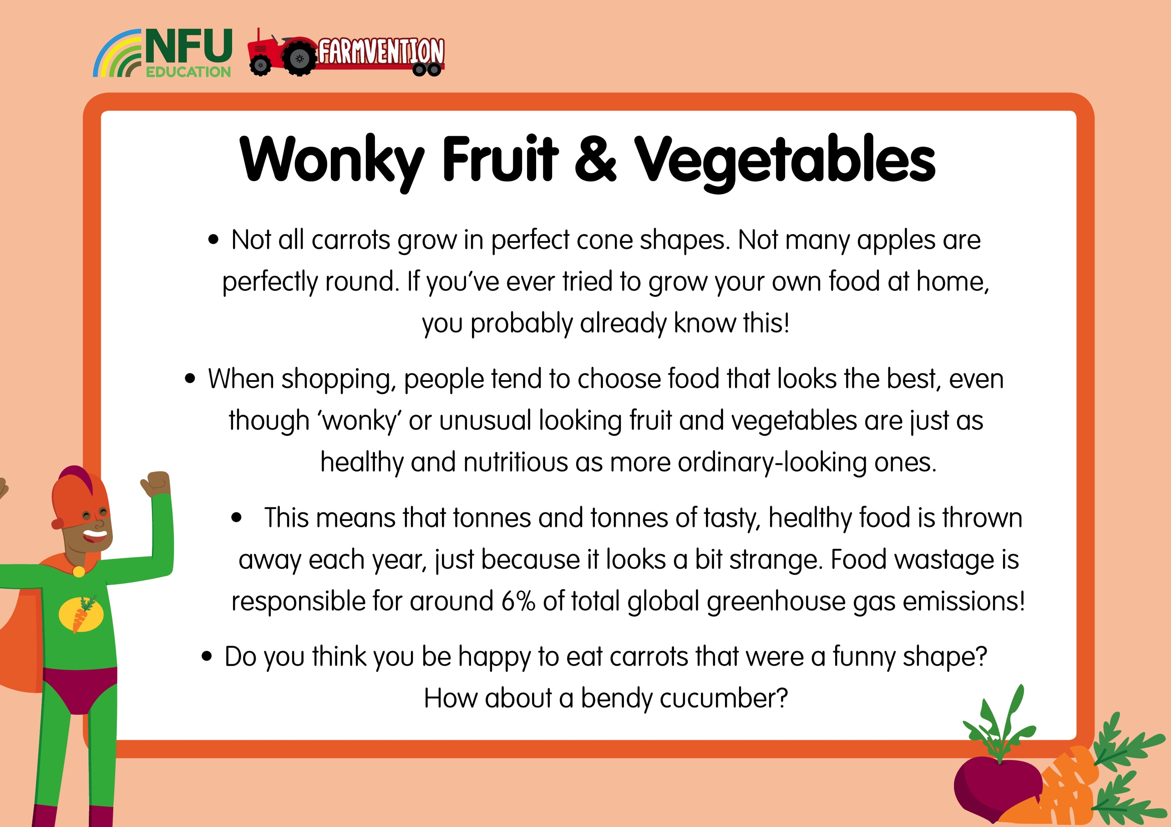
Notes:
Discuss with children their views on eating so-called ‘wonky’ fruit and vegetables. Have any of them tried to grow their own food before? Did it look like the produce we see in the shops? How did it taste?
Talk about some of the recipes and meals they are familiar with and consider whether or not you can tell what shape the vegetable was before it was added to the meal.

Slide 4
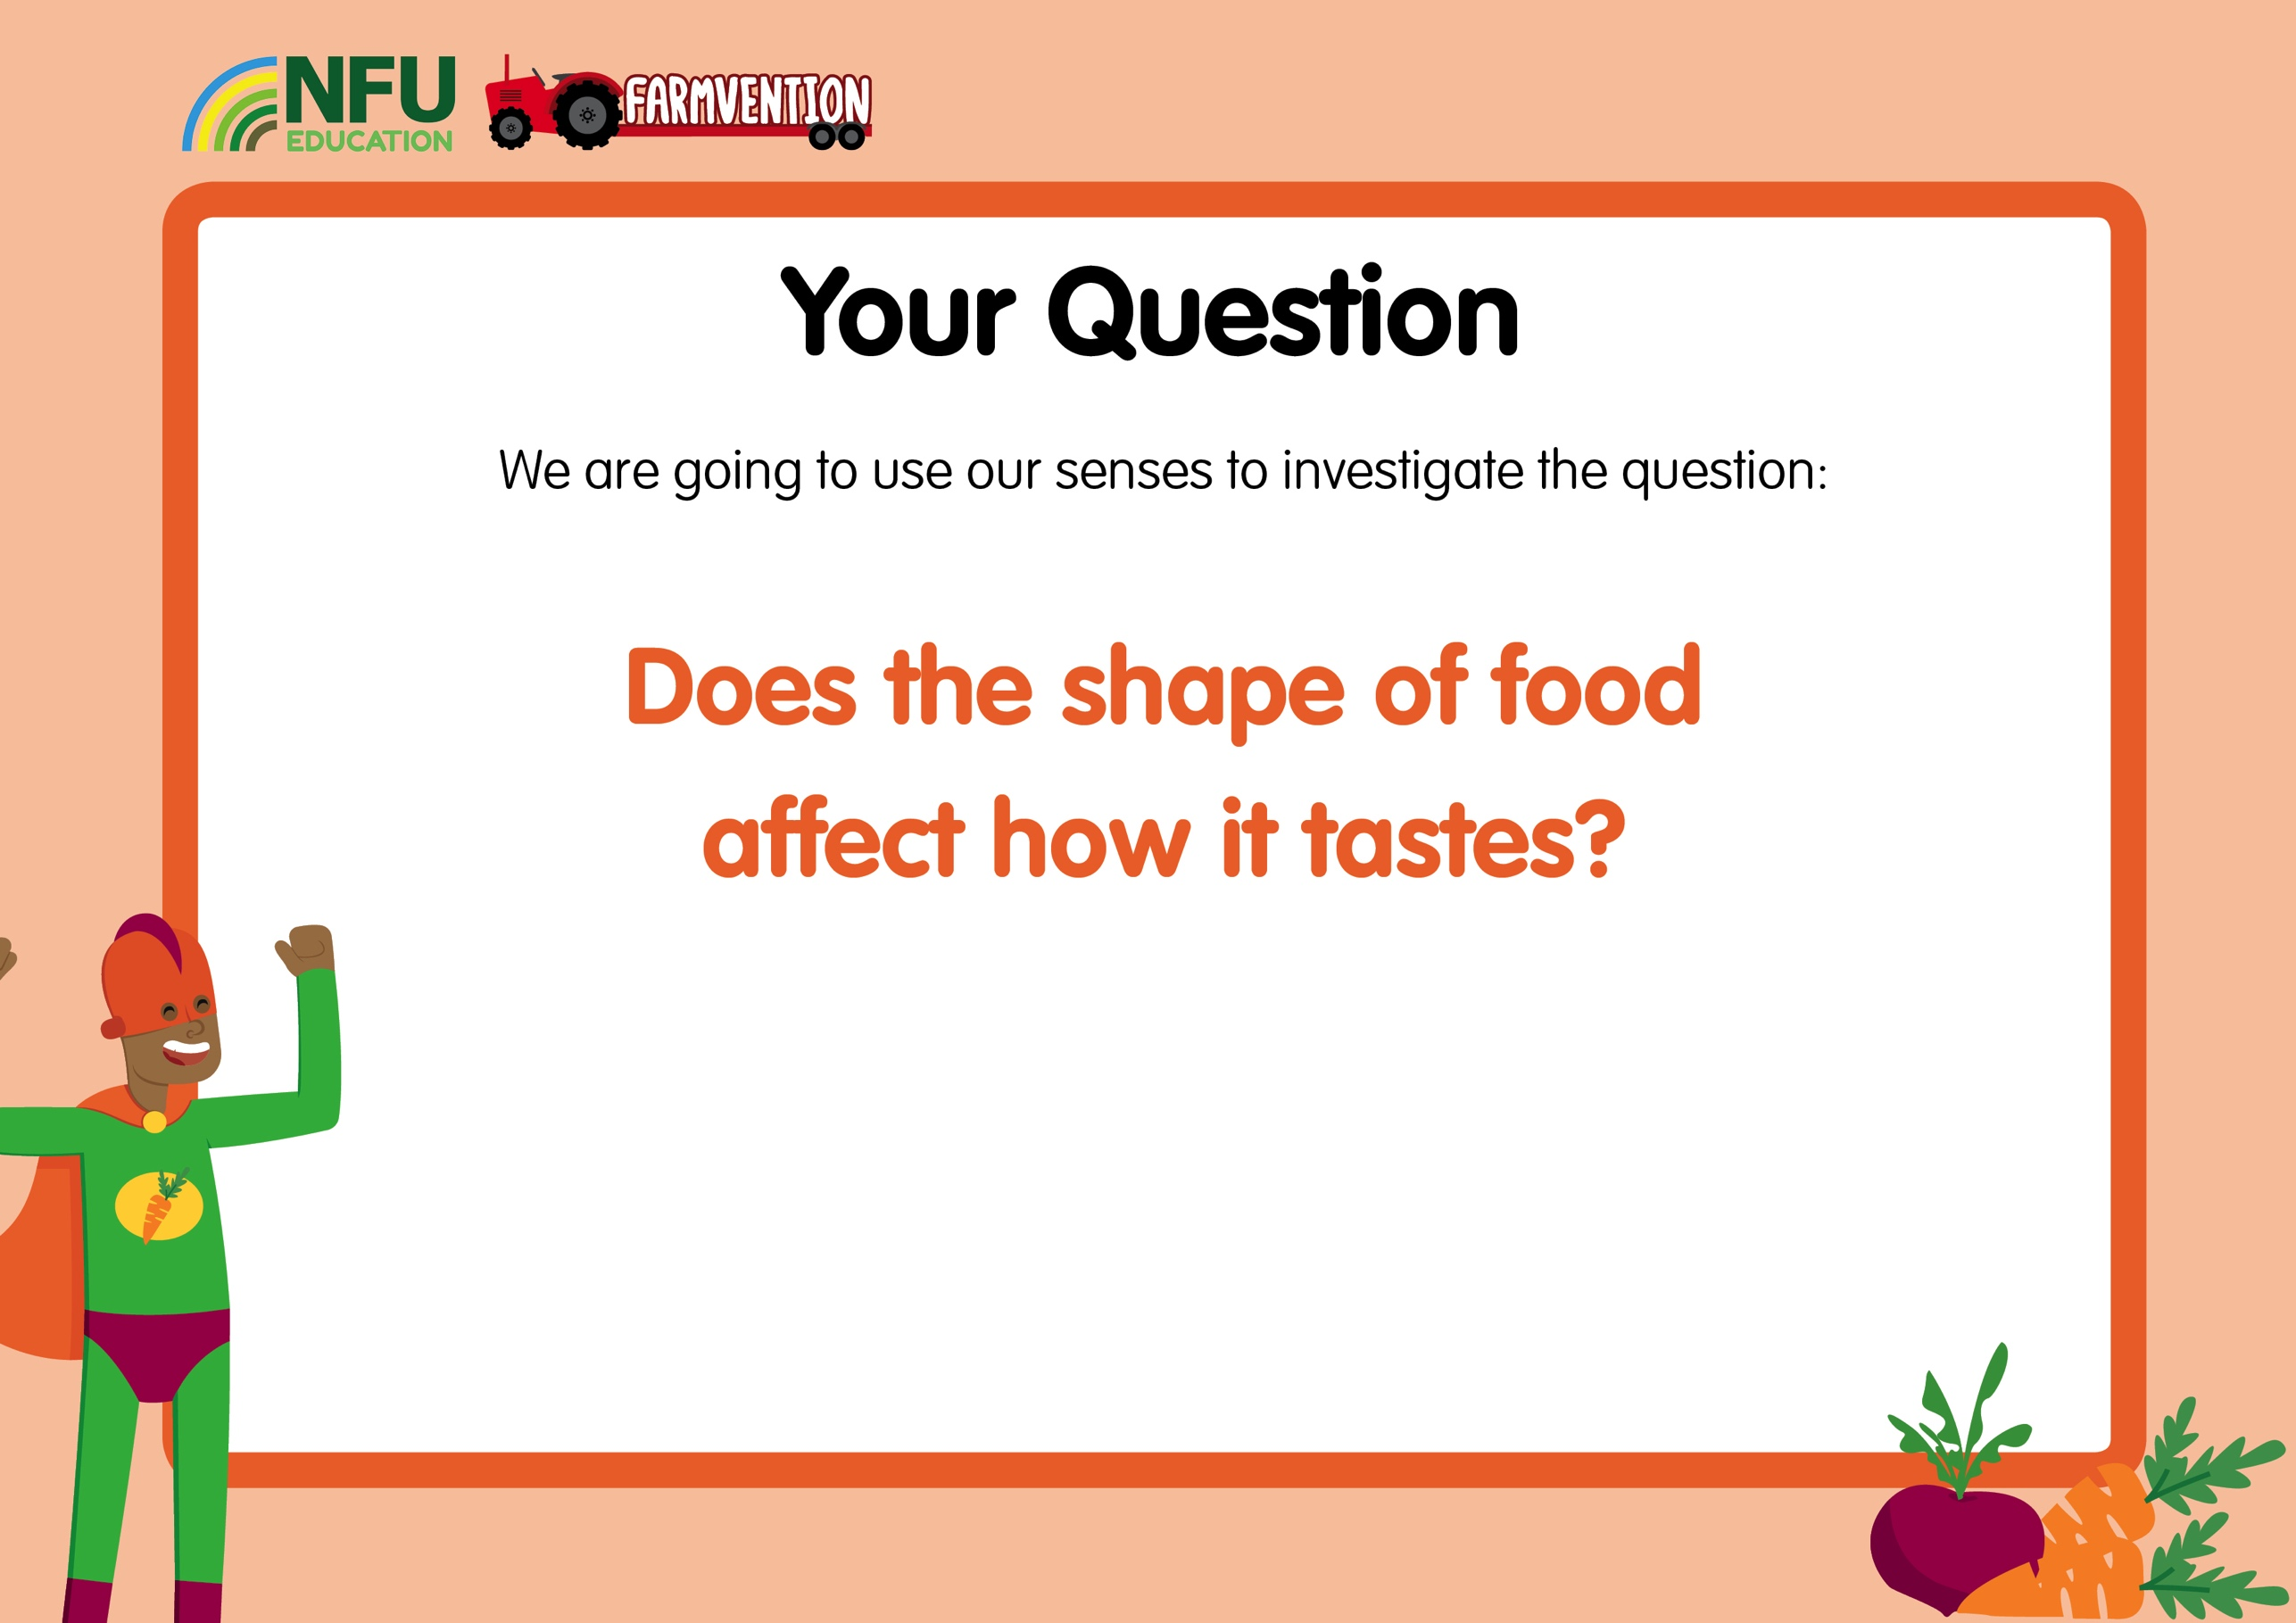
Notes:
Pose the project question to children and gather their initial thoughts.

Slide 5
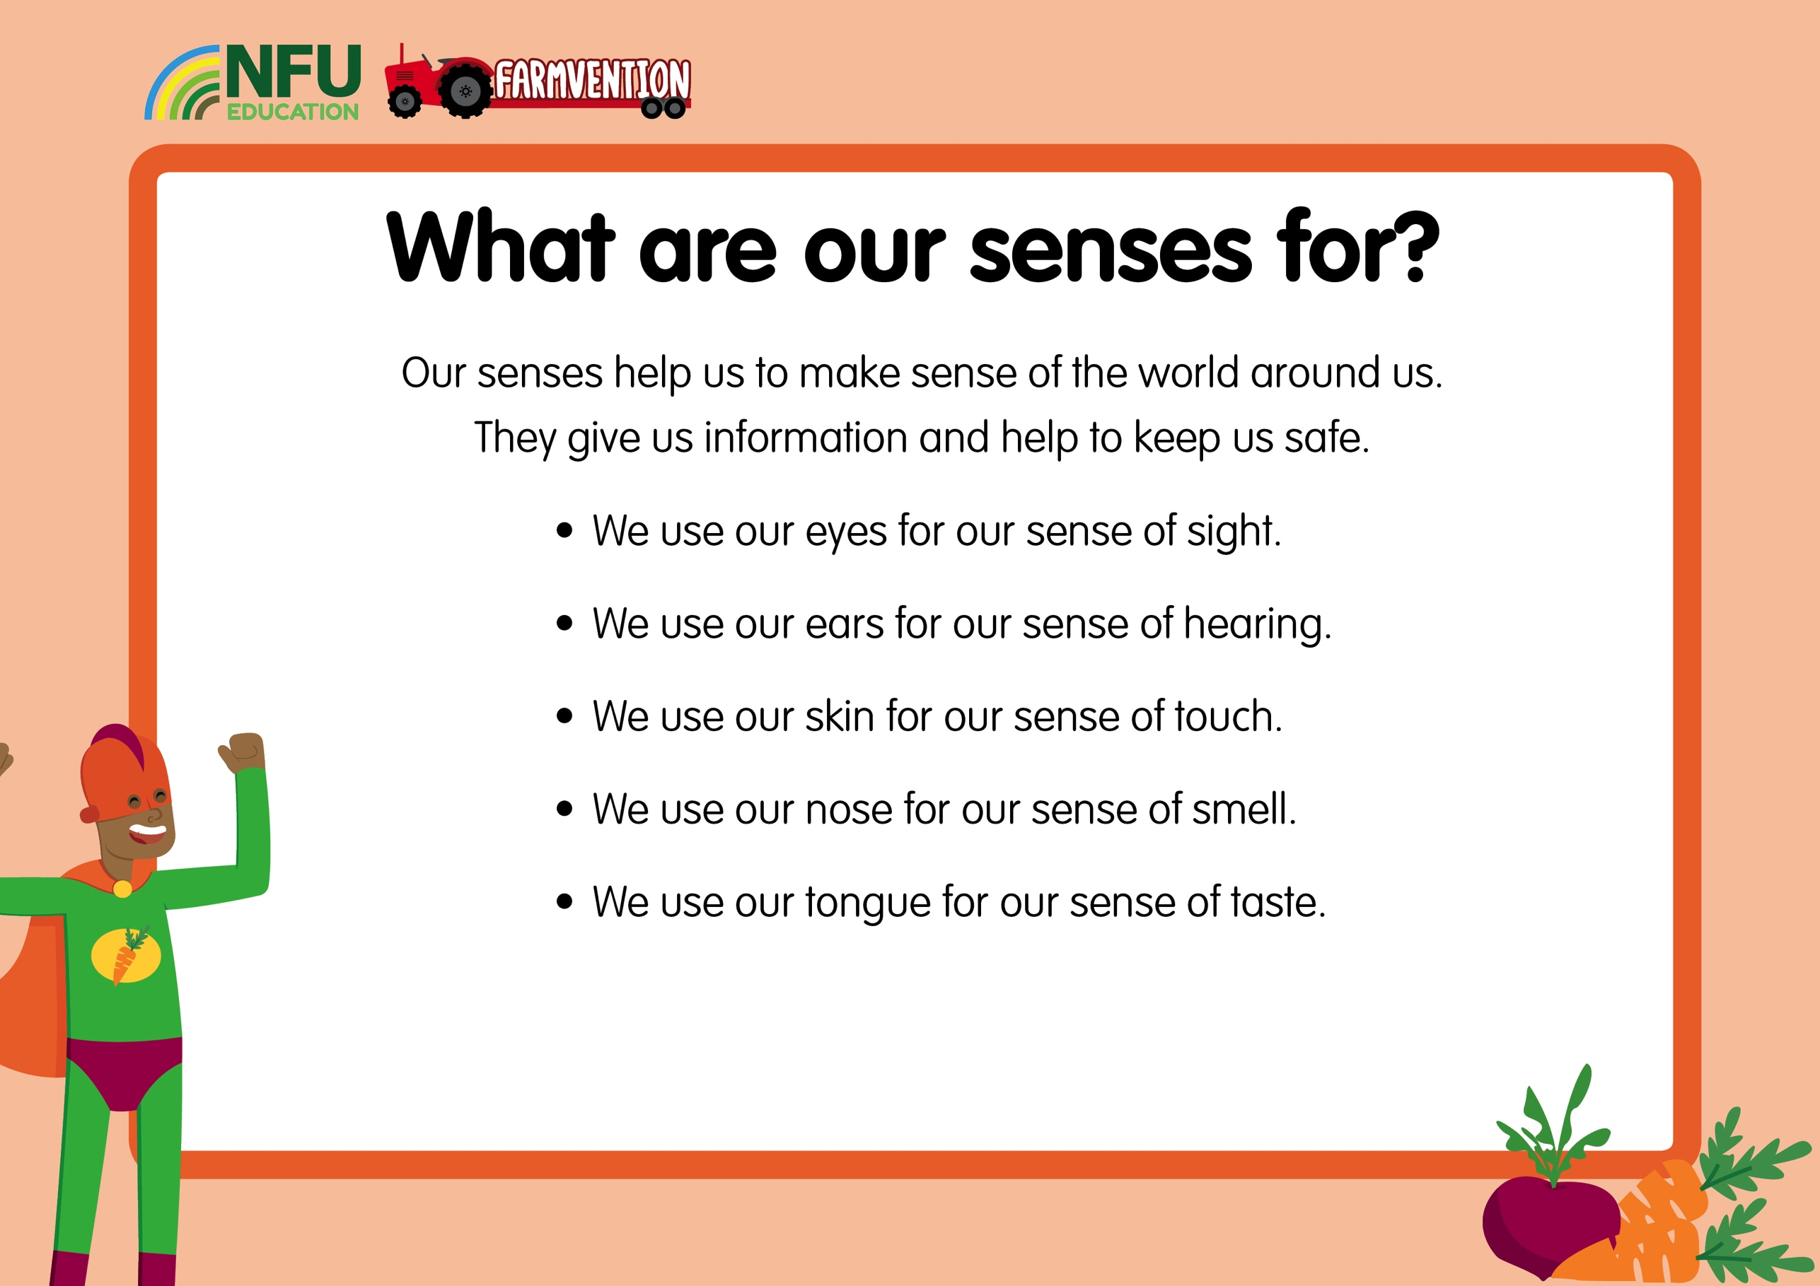
Notes:
The five senses children learn about when following the UK National Curriculum are the senses of sight, hearing, smell, touch and taste. These help us to make sense of the world around us and, importantly, keep use safe. For example, we can use our senses to help us identify food that might make us ill, time when it might be unsafe to cross a road or objects that might be too hot or sharp to touch.
Discuss with children when they have used each sense so far today, for example they may have used their sense of taste while eating their breakfast, or their sense of hearing to listen for their name during the register or their sense of sight to see when the light on the pedestrian crossing changed to green.
This video gives a look at senses in use on a farm:
https://www.youtube.com/watch?v=JCsQbE3-gfU&list=PLfQQD6ZJA60YhGhL-T9NhInlJGYiNi0vf&index=10

Slide 6
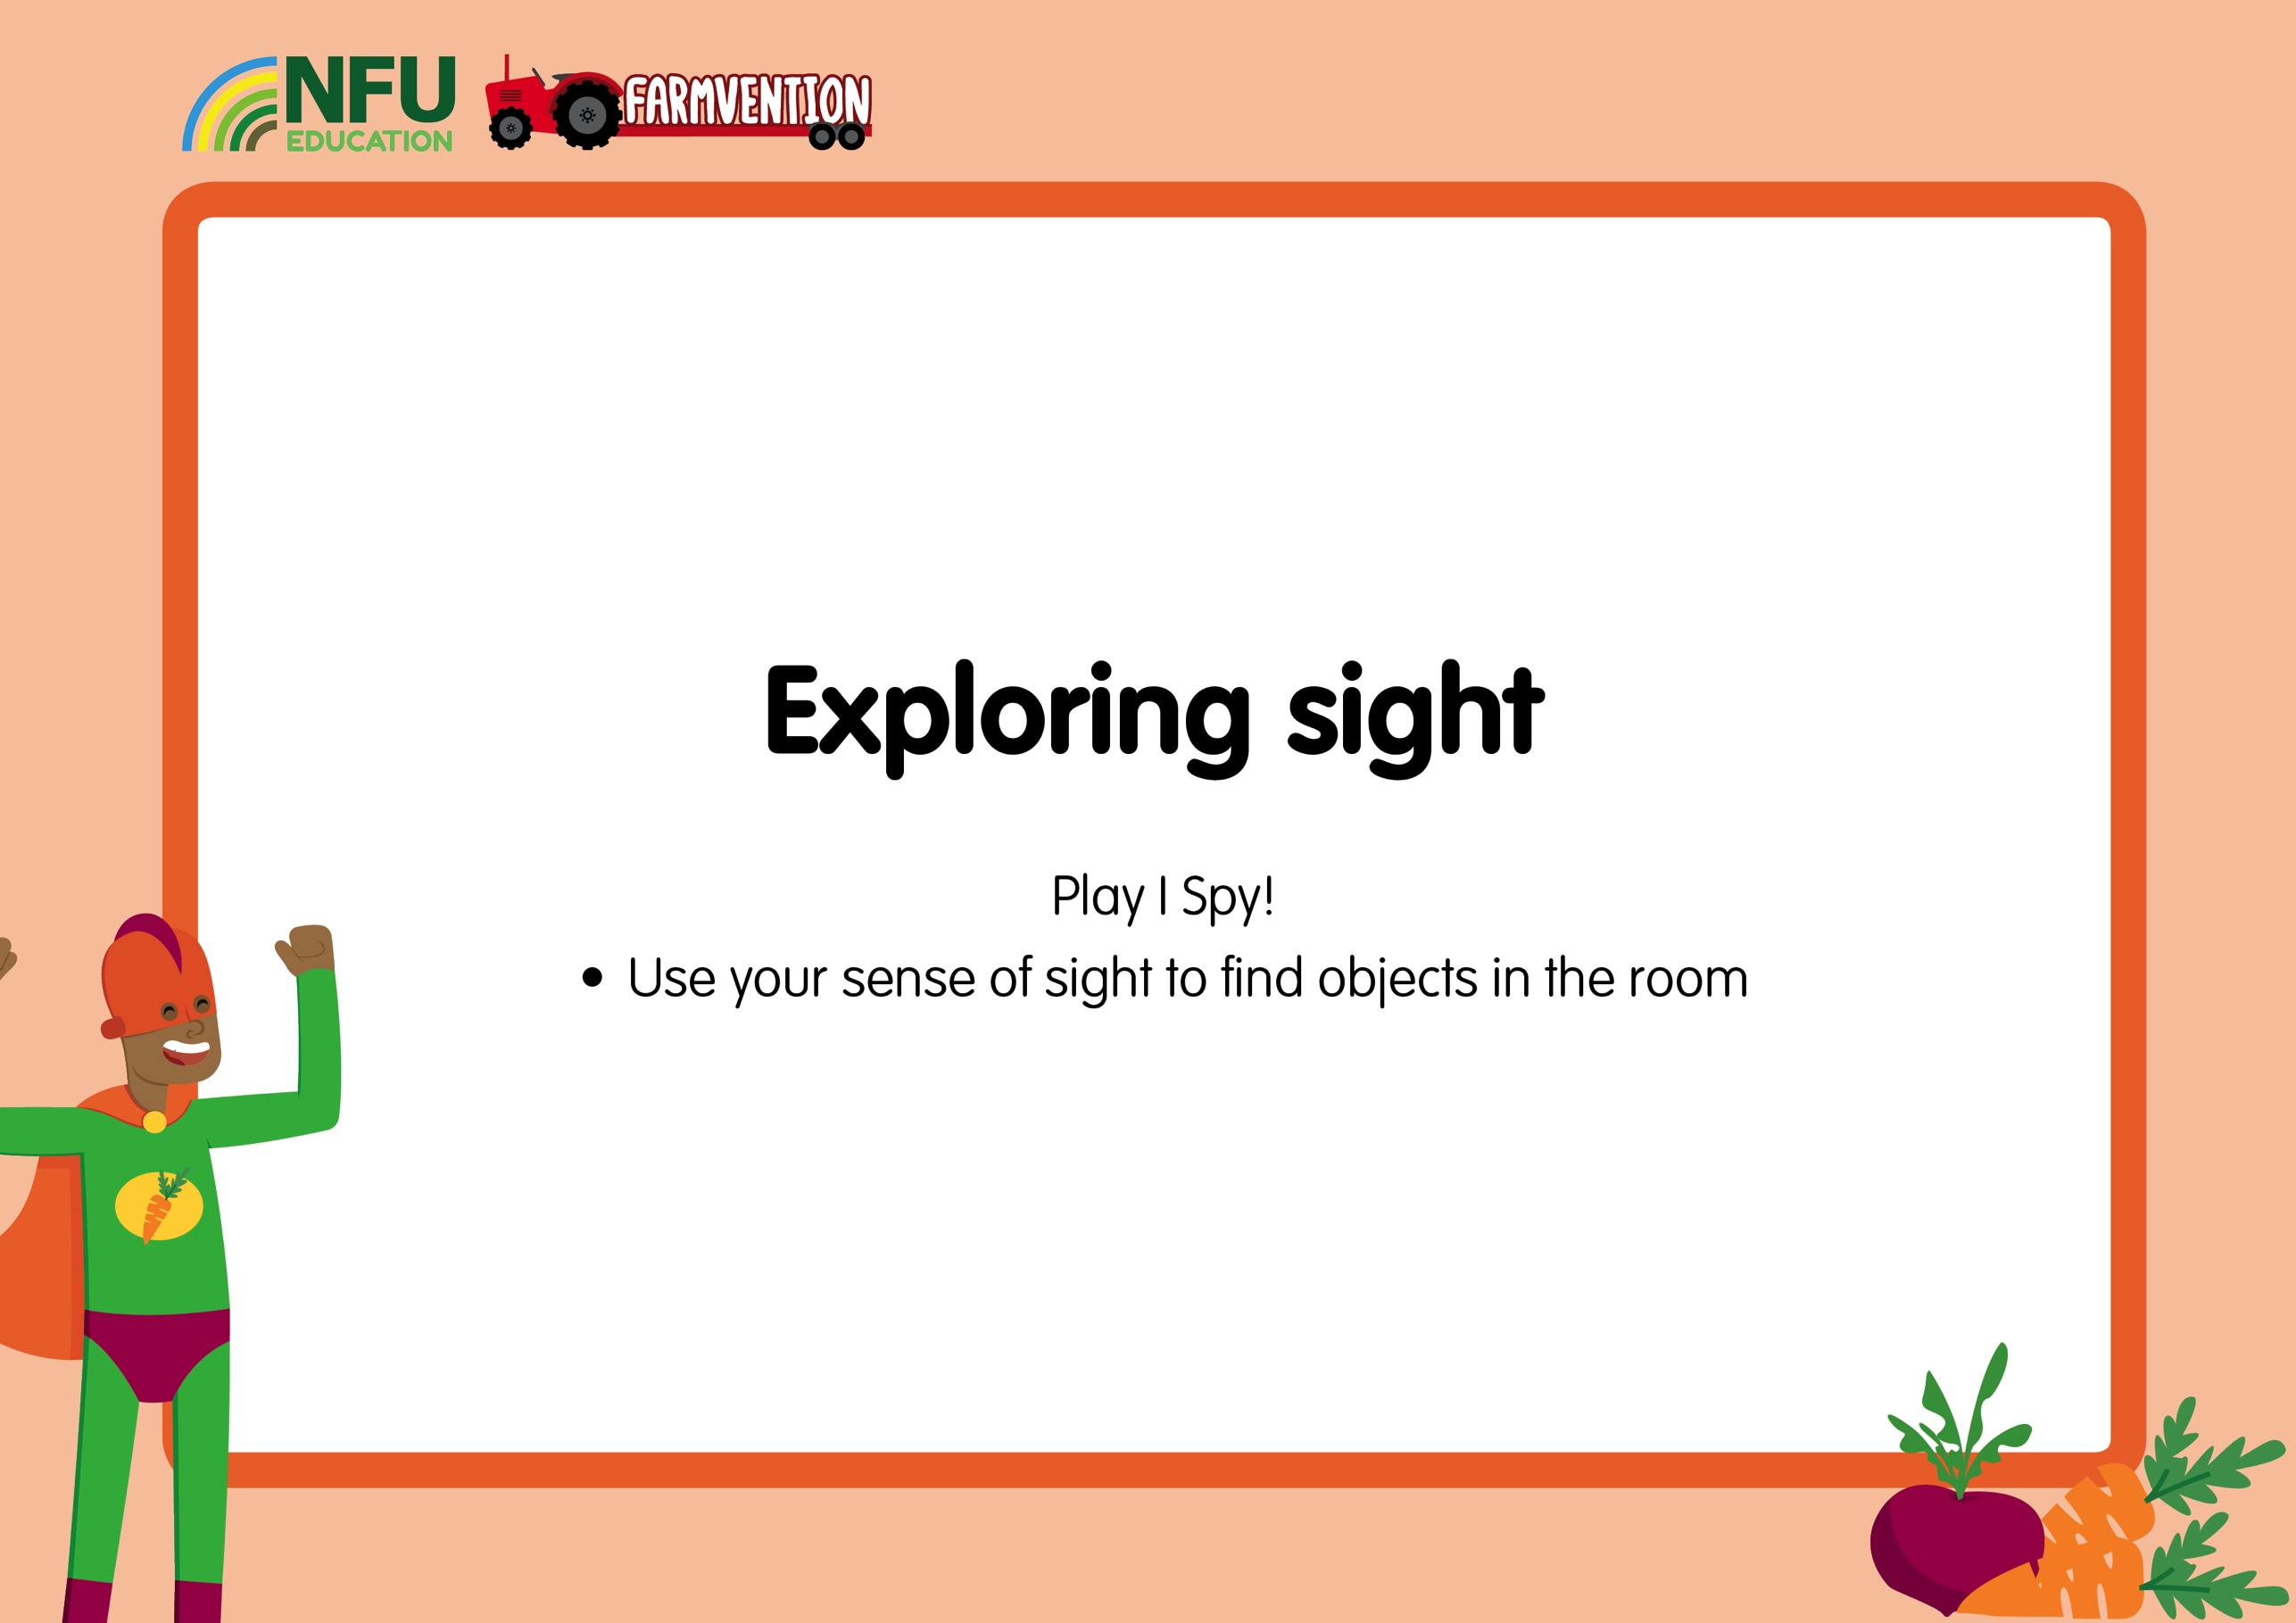
Notes:
You could play traditional ‘I Spy’ here, in which players look for something beginning with a particular letter, or you could give children the opportunity to practise their phonics skills by adapting the game so that they are looking for something that contains a certain sound. For example, “I spy with my little eye, something that has the ‘ar’ sound,” (carpet, arm, garden etc.)
Throughout the game, reinforce that we are using our eyes and sense of sight to find the objects.

Slide 7
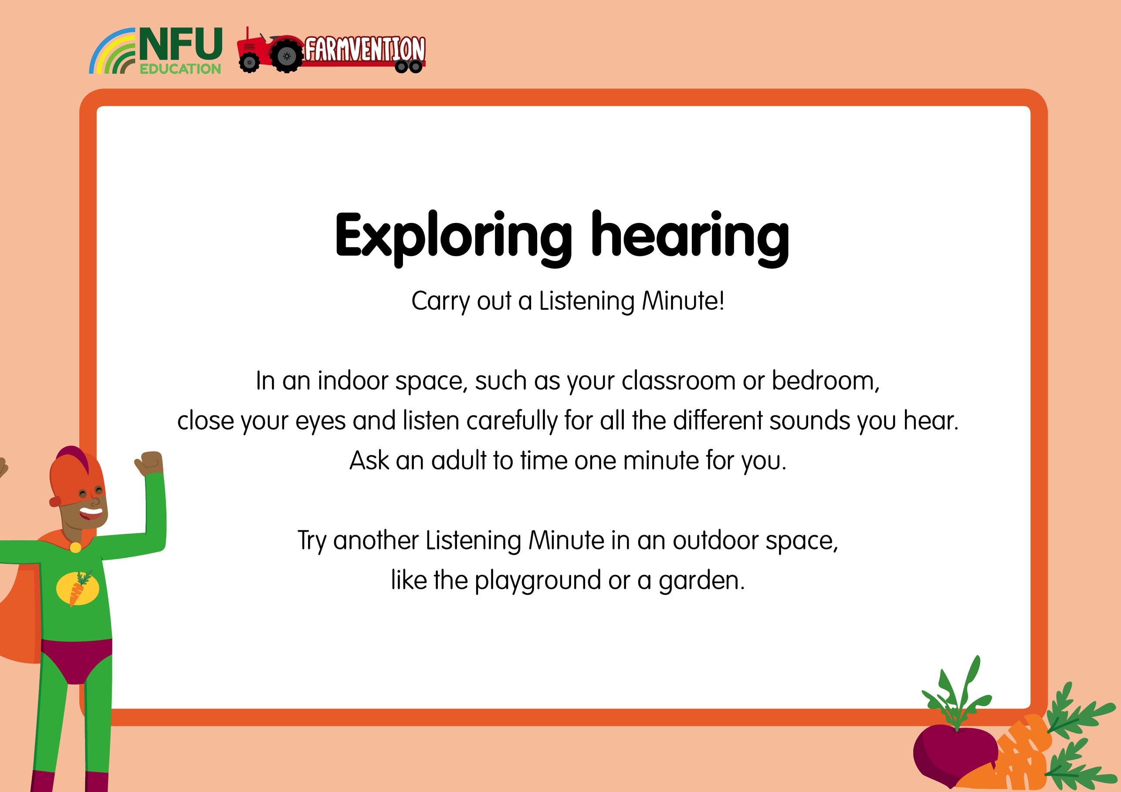
Notes:
Ensure children keep their eyes closed during their listening minutes so that they are only using their sense of hearing to identify things. You could ask them to write lists of the things they hear. Alternatively, you could play them some sounds found online and see if they can identify the sources.
Throughout the activity, keep reminding the children that they are using their sense of hearing and ears to identify things.
Questions to ask:
Did you hear the same sounds indoors and outdoors?
How easy or hard was it to work out what was making all the different sounds?
Were all the sounds the same volume, or were some louder and some quieter sounds?

Slide 8
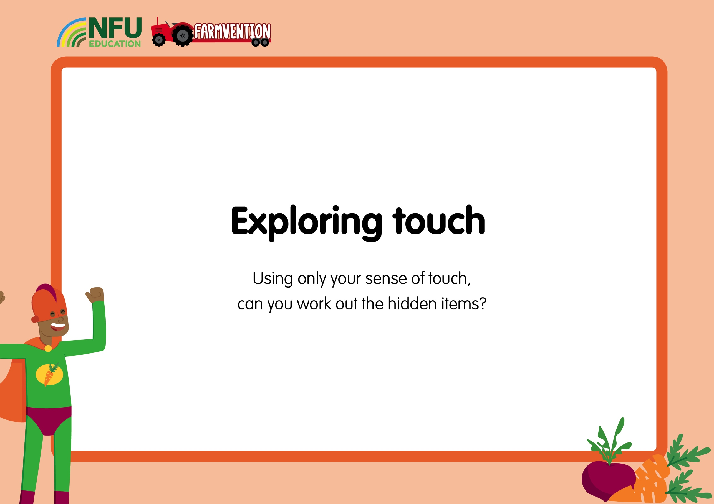
Notes:
Hide a selection of familiar objects in an opaque bag or box and ask children to reach inside and try and identify the items.
Throughout the activity, keep reminding the children that they are using their sense of touch and skin to identify things.
Children can think that they just use their hands for their sense of touch, not their skin. To help them learn that it is our skin and not just our hands that use our sense of touch, offer them two very different objects, such as a teddy and a book, and ask them to identify which is which using only their feet, forearms or tummy, with eyes closed.
Questions to ask:
Was it easy or hard to work out what was hidden using only your sense of touch?
Could you tell if the objects were soft or hard?
Could you tell what colour they were?
Could you tell if they were rough or smooth?

Slide 9

Notes:
Hide some familiar-smelling objects in small opaque cups or yogurt pots, cover the top with a piece of paper or kitchen towel with small holes poked in and secure this in place with an elastic band. Ask children to smell each pot and try and identify what is inside. Foods which work well in this activity include oranges, lemons, coffee grounds, mints, garlic, onion, curry powder and some cheeses.
Throughout the activity, keep reminding the children that they are using their sense of smell and their nose to identify things.
Questions to ask:
Was it easy or hard to work out what was hidden using only your sense of smell?
Were all of the smells nice or were there some that you didn’t like?
Was it easy or difficult to work out what was in each cup?
Health & Safety – Make sure you are aware of any allergies in your class before allowing children to smell hidden foods.

Slide 10

Notes:
Carry out a blindfolded taste test of some familiar foods. You could offer children a range of different foods to try or limit the range to different kinds/flavours of the same thing, for example differently flavoured sweets, crisps or yogurts. Some children may be reluctant to try something they can’t see, and so using different flavoured crisps is a good option here as they will not need to be blindfolded. If you have access to food colouring, you could use them to give familiar yogurts a different appearance.
To truly limit children to just their sense of taste, you could also ask them to hold their noses so that they cannot use their sense of smell.
Throughout the activity, keep reminding the children that they are using their sense of taste and their tongue to identify things.
Questions to ask:
Was it easy or hard to work out what was hidden using only your sense of taste?
Were all of the smells nice or were there some that you didn’t like?
Was it easy or difficult to work out what was in each cup?
Health and Safety – Make sure you are aware of any allergies or dietary restrictions in your class before allowing them to taste any food.

Slide 11
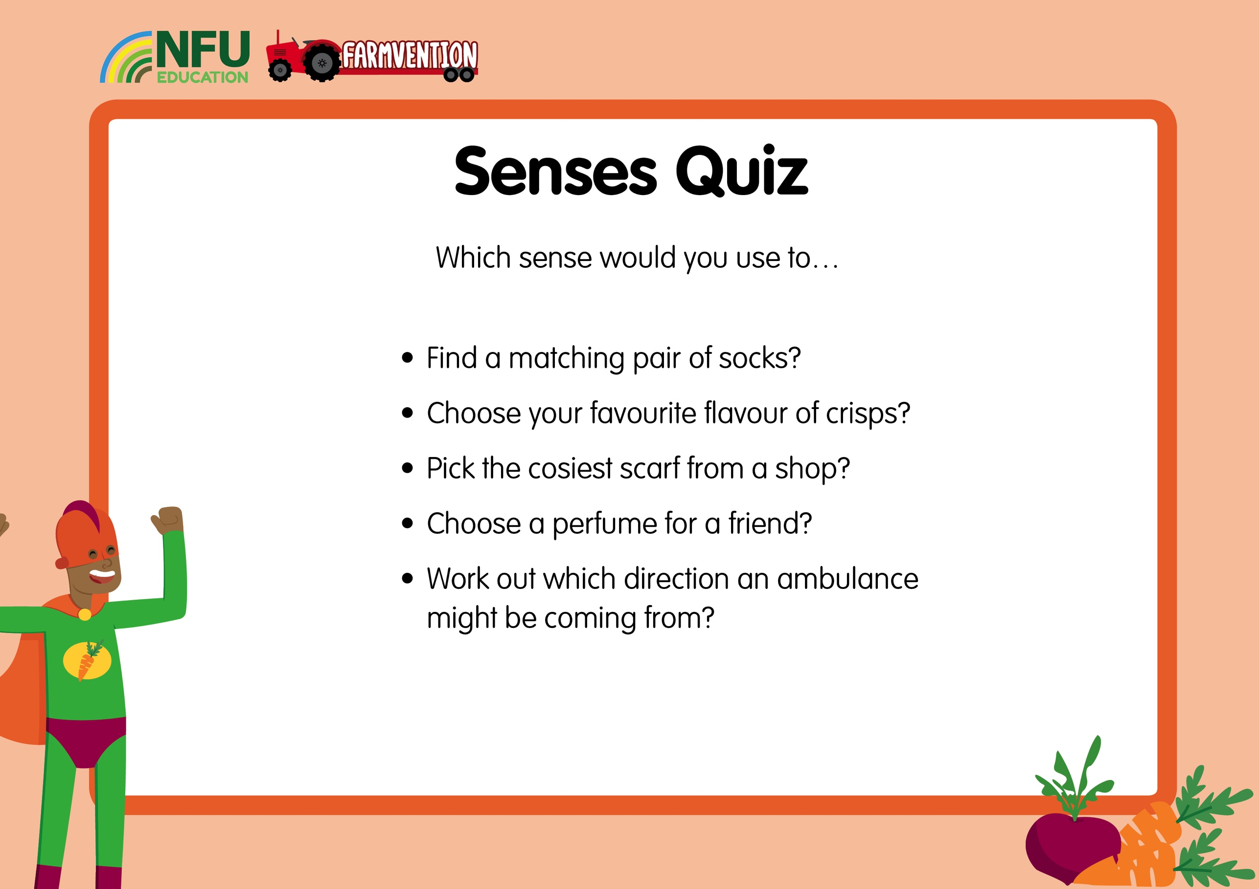
Notes:
Ask children to discuss which sense they would use for each activity. Humans rarely just use one sense in isolation so they may want to give more than one answer.

Slide 12
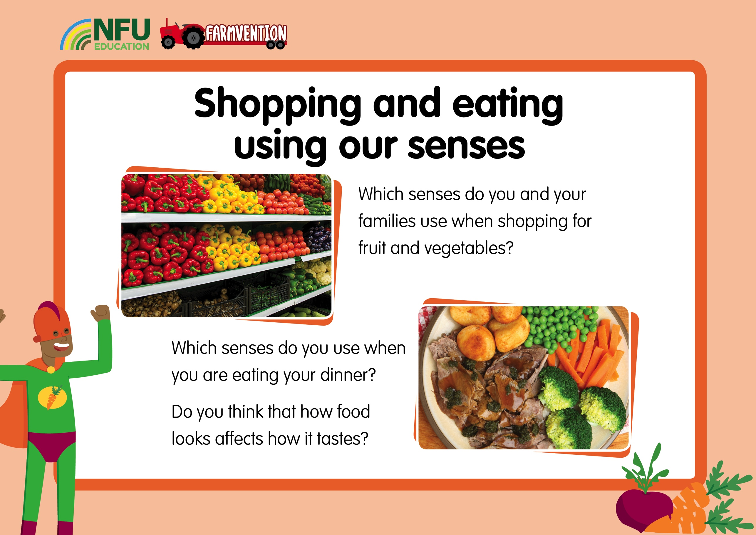
Notes:
Discuss the questions with children. If their parents/carers shop while they are not with them or use online delivery services, children may have limited experiences of shopping for fruit and vegetables. In this case, use the photos to talk about which vegetables they would pick and how they would decide which is best.

Slide 13
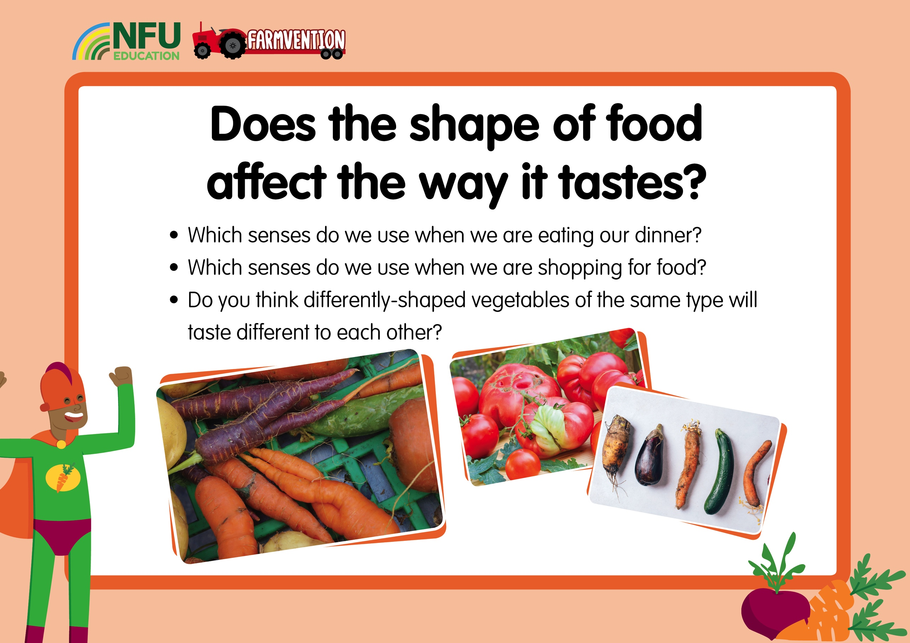
Notes:
Discuss how we use our senses when we are enjoying our food. Research has shown that we do, to some extent, ‘eat with our eyes’, and our perception of how something tastes is affected by the way it looks.
Discuss the pictures of differently-shaped fruits and vegetables and how children think their shape might affect their taste, linking in previous learning about senses.
It is very likely at this point that children will say the more regular-looking fruits and vegetables will taste better.
Show children three or more examples of a fruit/vegetable that are differently shaped, some of which look more regular than others. If you find it difficult to find unusually-shaped produce, you could add some dirt or surface scuffs to one of your veg that will not affect the taste or usability of the food. Good foods to choose for this include carrots, apples, peppers, satsumas, grapes, cucumbers, strawberries or tomatoes.
Questions to pose to the children:
Which of these three [strawberries] would you most like to eat?
Which do you think will taste best?
Why do you think this one will taste best?
Health & Safety – Make sure you are fully aware of any allergies in the class before allowing children to handle produce.

Slide 14
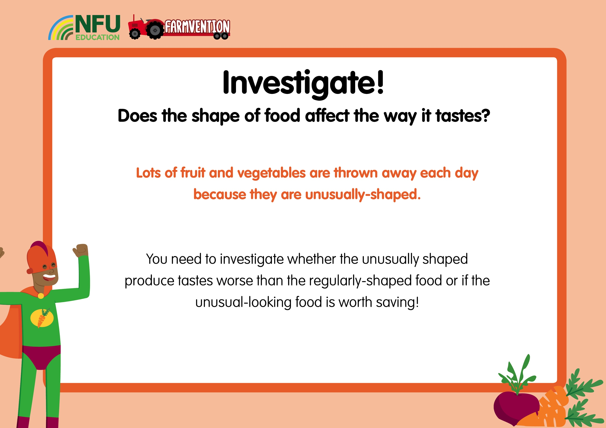
Notes:
Questions to pose to the children:
Which sense will we use to find out how yummy different vegetables are? Which sense organ do we use for this sense?
How will you find out which one tastes best?
How will you make sure you are not judging the food by the way it looks?
It is likely that children will need a lot of guidance in planning this investigation, and so this discussion should be carried out as a class and a method agreed upon together. Possible suggestions for carrying out the investigation include:
Asking children to rank three of the same type of fruit/vegetable according to which looks the tastiest and recording this, then carrying out a blindfolded taste test or tasting a piece of each that has been cut up in such a way that all three pieces look identical or very, very similar and again ranking them according to which tastes better. This will need careful monitoring by an adult to make sure it is remembered which tasting sample came from which fruit/vegetable.
Allowing children to take a good look at two examples of the same fruit/vegetable, one of which is ‘wonky’ and another of which is a more regular shape. Children then have a blindfolded taste test or taste pieces that have been cut up and prepared in such a way that they can’t tell which is which and seeing if they can identify which samples came from the wonky produce.
To minimise food waste, this activity could be done at snack time when the children would have been eating healthy snacks anyway. If carrying out this task at home, this food could form part of lunch or a snack – it would be great to get the whole family involved!
If possible, try to investigate more than one kind of produce. This activity could be carried out over a number of days, with a different food being tried each day.

Slide 15
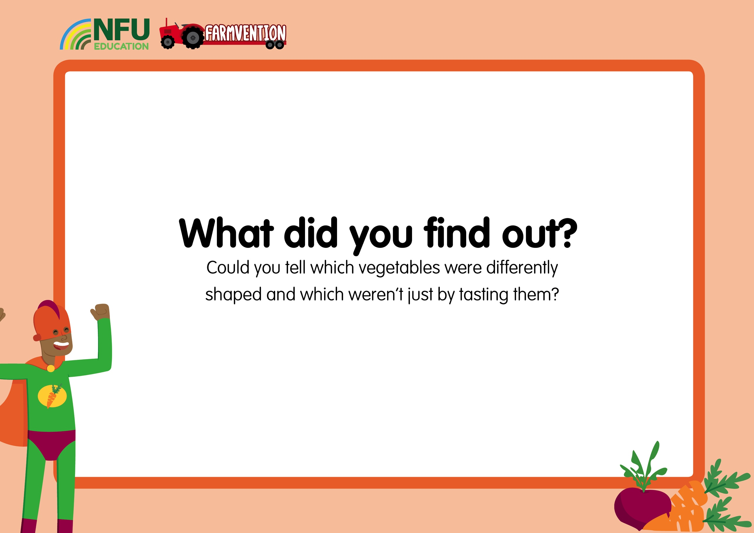
Notes:
Questions to ask:
Were you able to work out which vegetables were the wonky ones just by tasting them?
Were you surprised by what you found out?

Slide 16
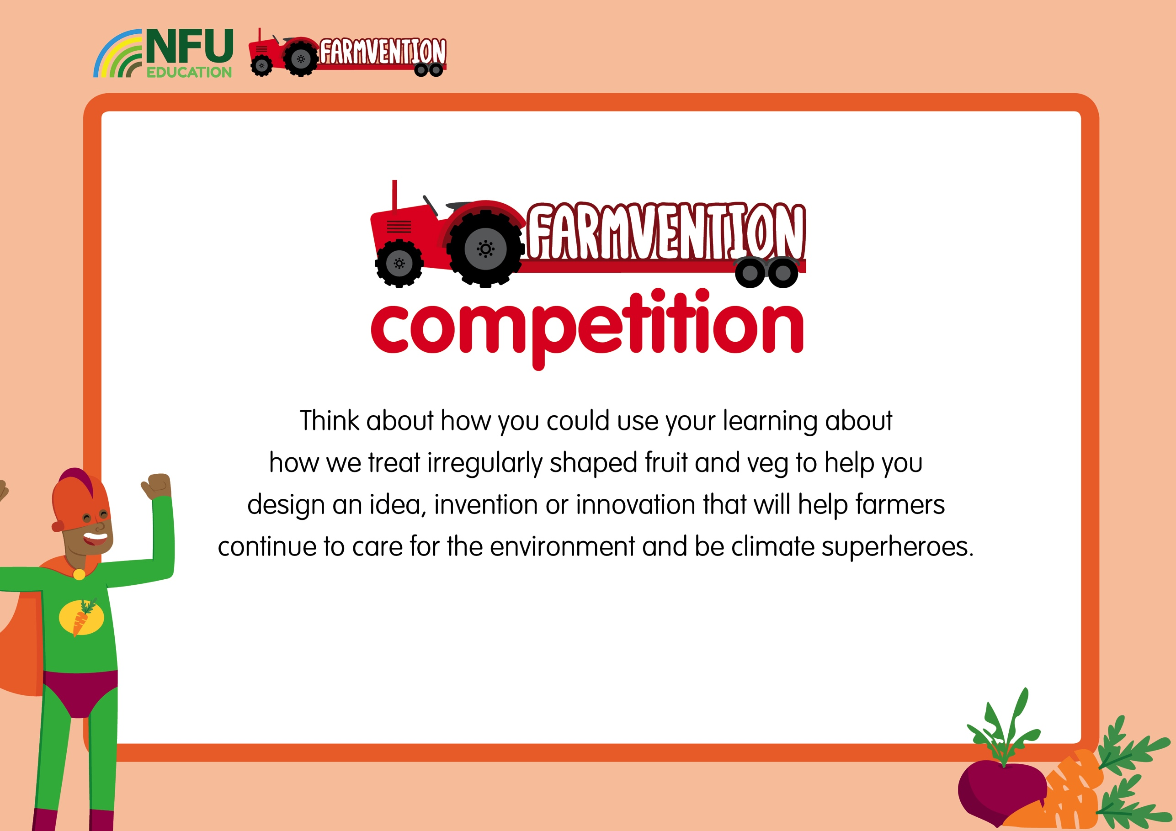
www.farmvention.com

